Slide 1
ASP.NET CORE WEB APP
Name: Mehakjot Kaur
Student Number:200447070
Professor Name: Nital Shah

Slide 2

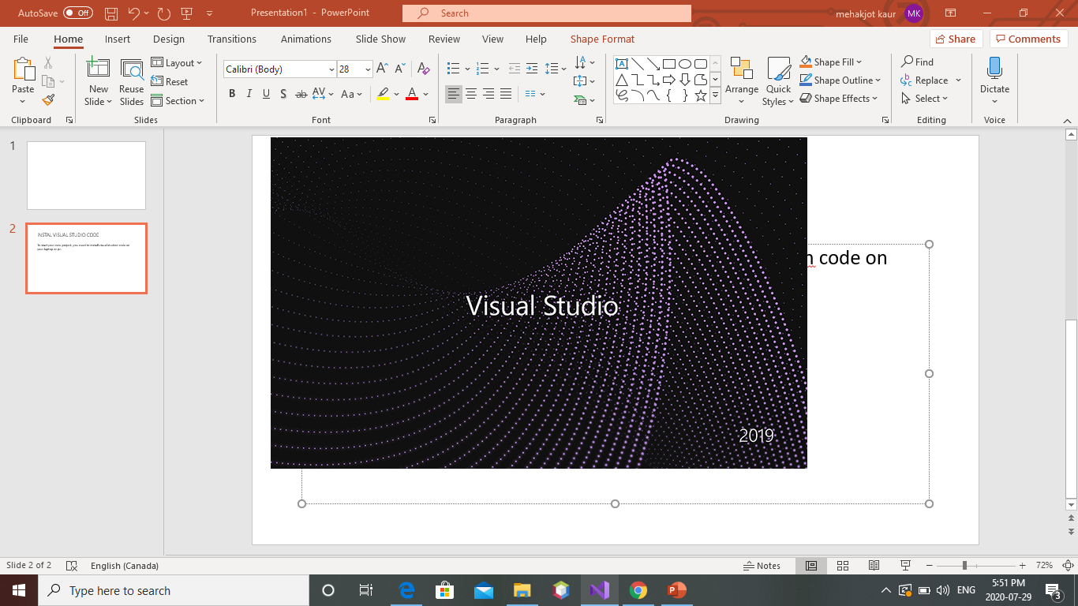
INSTALL VISUAL STUDIO CODE
To get started with your project , firstly you need to install visual studio code.

Slide 3
CREATE YOUR FIRST ASP.NET CORE WEB APP

Slide 4
START VISUAL STUDIO AND CREATE NEW PROJECT
Start Visual Studio 2019 and click Create new project.
Choose ASP.NET Core Web Application.
Choose the Web Application template and keep the default project name and location. In the dropdown with the ASP.NET Core version, choose ASP.NET Core 2.1 or ASP.NET Core 2.2. Click Create.

Slide 5
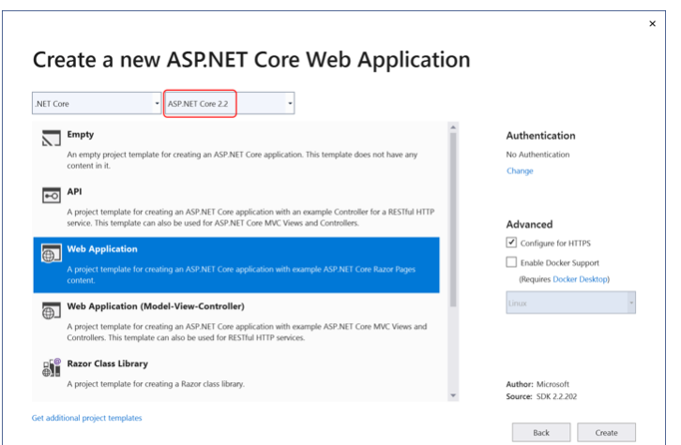
#Create a new asp.net core web application

Slide 6
Explore the new project
In the solution explorer window on the right, you can view the contents of the new project.
www.root:The wwwroot folder holds static files that will be publicly accessible from the web application. It typically holds stylesheets, client-side script files, and images.
Pages: The Pages folder holds the site's Razor Pages. The default template provides several pages, including the Index.cshtml page.
Appsettings.json: This file holds configuration settings for the site, in JSON format.
Program.cs: This file acts as the entry point for the application. When the app is run, its Main method is the first method that is run and is responsible for creating the Web Host that will contain the application.
Startup.cs: The home page for the site incudes some html markup and server-side razor code.it uses razor to specify the page model,index modelwhich is located in the associated Index.cshtml.cs file.

Slide 7
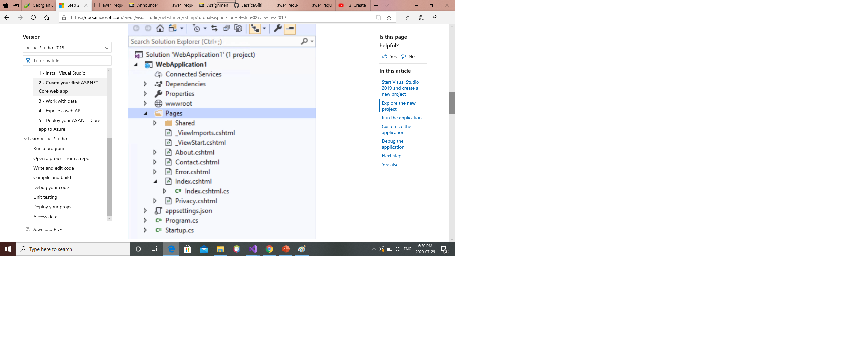
.
.

Slide 8
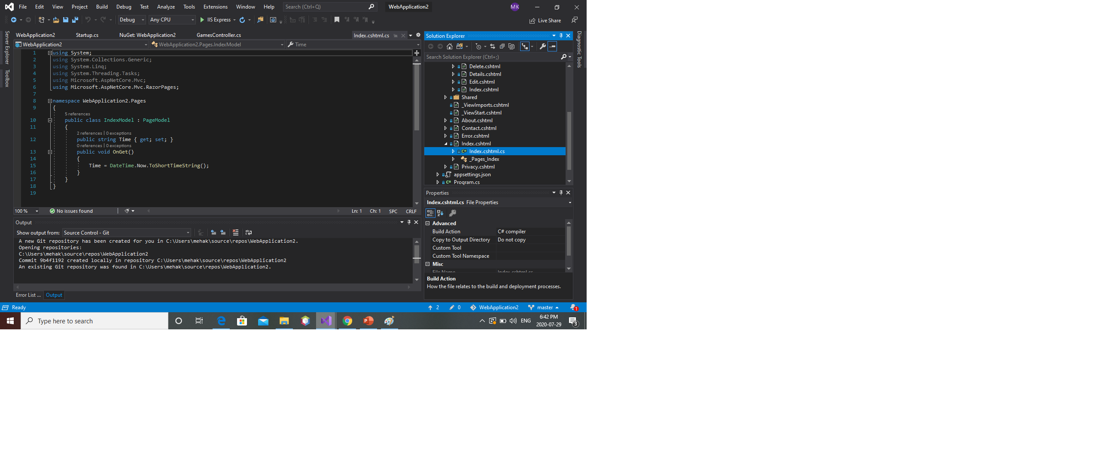
Customize the application
add a property to the Index.cshtml.cs file

Slide 9
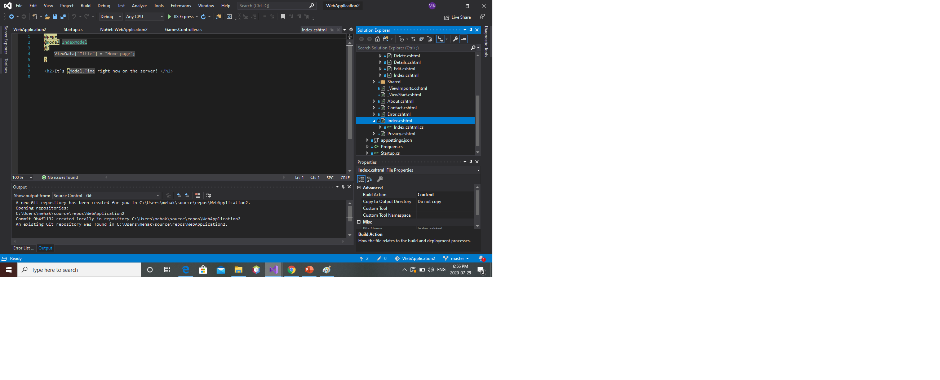
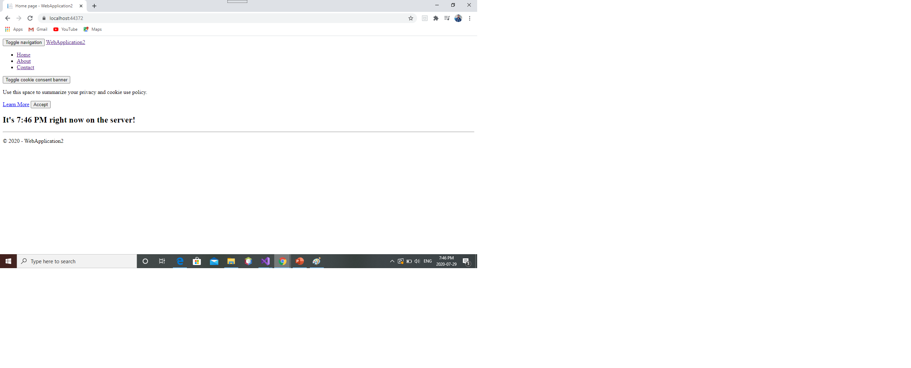
Replace the <div> content in Index.cshtml with this markup:

Slide 10
Work with data using Entity Framework

Slide 11
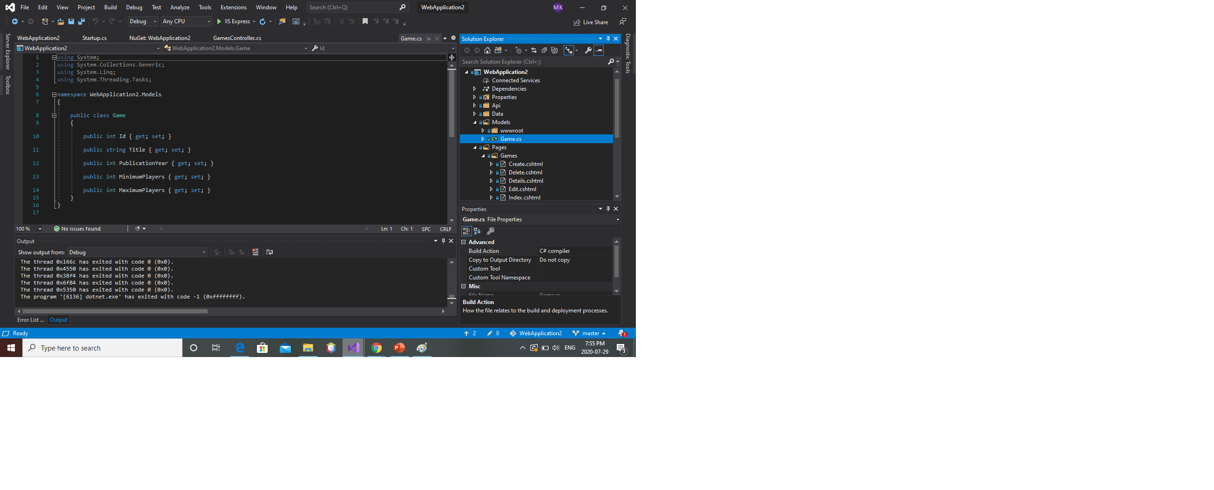
Add your model
to describe what the data should look like is the first thing you need to do to work with data in your ASP.NET Core application . We call that creating a model of the things. In real world applications, we'll add custom business logic to these models so they can behave in certain ways and automate tasks for us. For this sample, we're going to create a simple system for tracking board games. We need a class that represents a game and includes some properties that we might want to record about that game, like how many players it can support. This class will go into a new folder we'll create in the root of the web project, called Models.

Slide 12
Create the pages to manage your game library
Open the Pages folder in the web project and add a new folder there. Call it Games.
right click on Games and choose Add > New Scaffolded Item. Choose the Razor Pages using Entity Framework (CRUD) option. CRUD stands for "Create, Read, Update, Delete"
Select your game model class and use it ‘+’ icon to add a new data context class.name it as AppDbContext. Leave the rest as default and click add.

Slide 13

the following Razor Pages added to your Games folder: * Create.cshtml * Delete.cshtml * Details.cshtml * Edit.cshtml * Index.cshtml

Slide 14
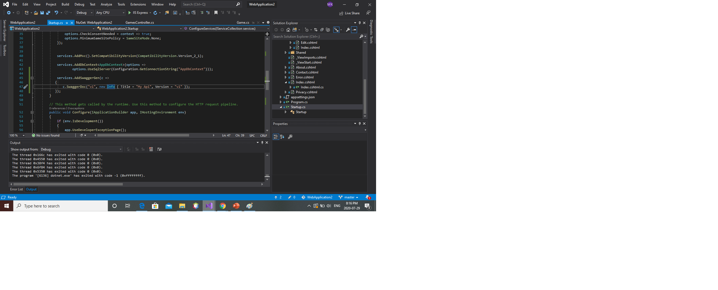
In the Games folder, the scaffolding operation added code to my Startup.cs class. Looking in the ConfigureServices method

Slide 15
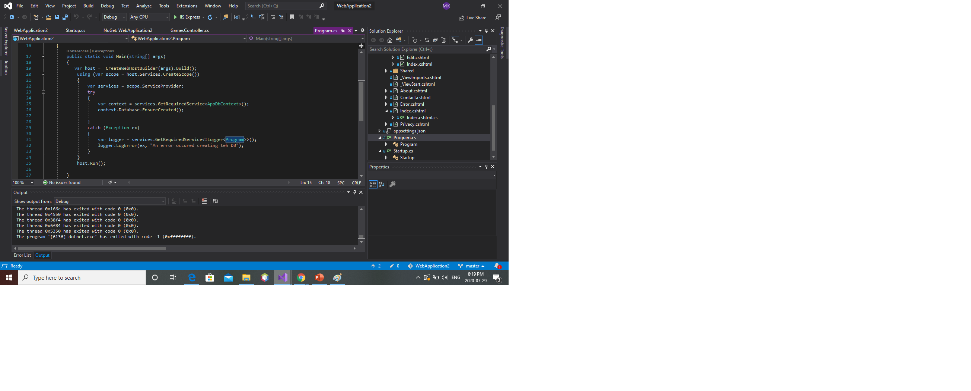
create the database by adding some code to Program.cs:

Slide 16
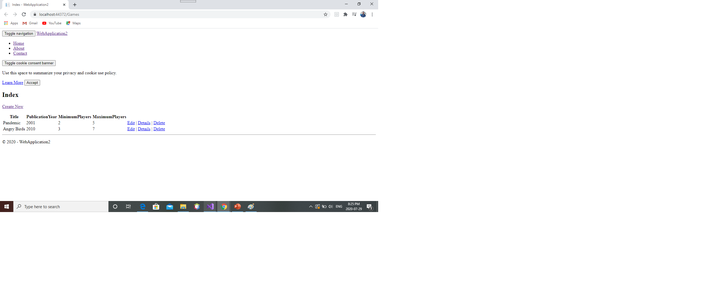
Test It Out
Run the application and navigate to /Games in the address bar.
You will see an empty list page.
Click Create New to add a new Game to the collection.
Fill in the form and click Create.
Click on Details to see the details of a single record.
Add another record. You can click Edit to change the details of a record or Delete to remove it.

Slide 17
Expose a web API from your ASP.NET Core app

Slide 18
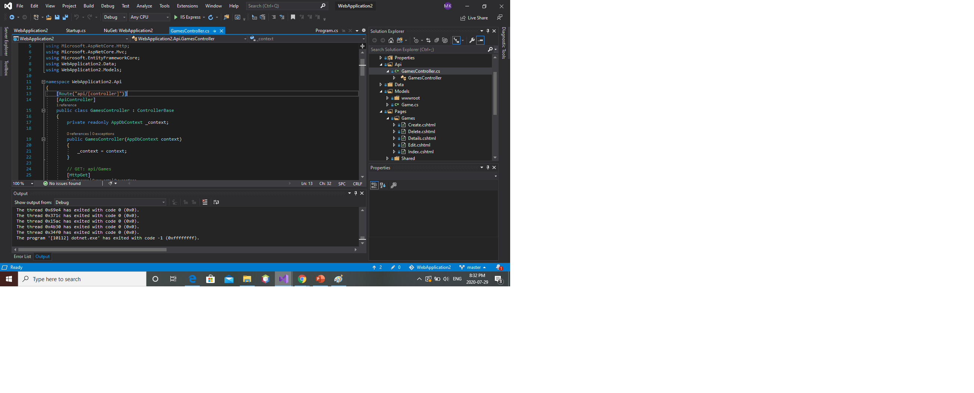
* Open your ASP.NET Core app in Visual Studio 2019. * Right click on the project and add a new folder called Api. Then, right click on this folder and choose Add > New Scaffolded Item. Choose API Controller with actions, using Entity Framework. Now choose an existing model class and click Add.

Slide 19
The second attribute, [ApiController], adds some useful validations to the class.

Slide 20

The controller uses the existing AppDbContext, passed into its constructor.

Slide 21
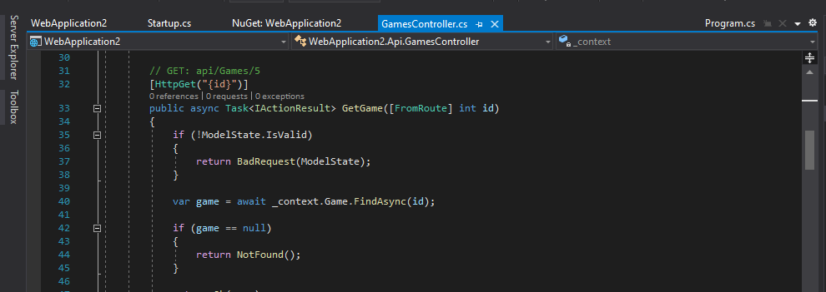
A simple GET request, as specified using the [HttpGet] attribute.

Slide 22

The next method specifies {id} in the route, which will be added to the route following a / so the full route will be something like api/Games. The id input is mapped to the id parameter on the method.

Slide 23
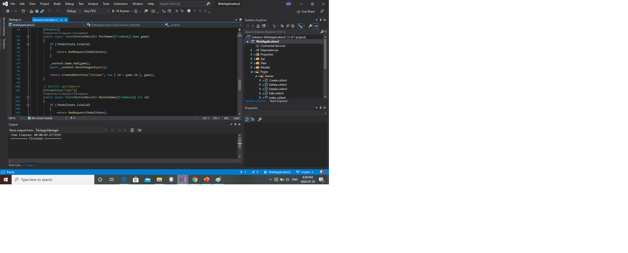
Next, an [HttpPut] request made to the API is used to perform updates .
An [HttpPost] request is used to add new records to the system. As with the [HttpPut], the record is added in the body of the request.
Finally an [httpdelete] is used to delete the record.

Slide 24
Adding Swagger
Swagger is an API documentation and testing tool that can be added as a set of services and middleware to an
ASP.NET Core app.
To do so, right-click on the project and choose Manage NuGet Packages.
Then, click Browse, search for Swashbuckle.AspNetCore, and install the 4.0.1 version.

Slide 25
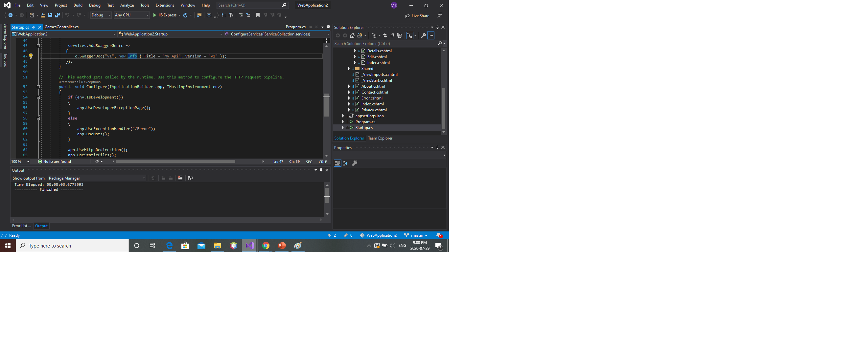
Open Startup.cs and add the following to the end of the ConfigureServices method:
Add using Swashbuckle.AspNetCore.Swagger;
Add the following code to the configure methods just before UseMVC.

Slide 26


Slide 27
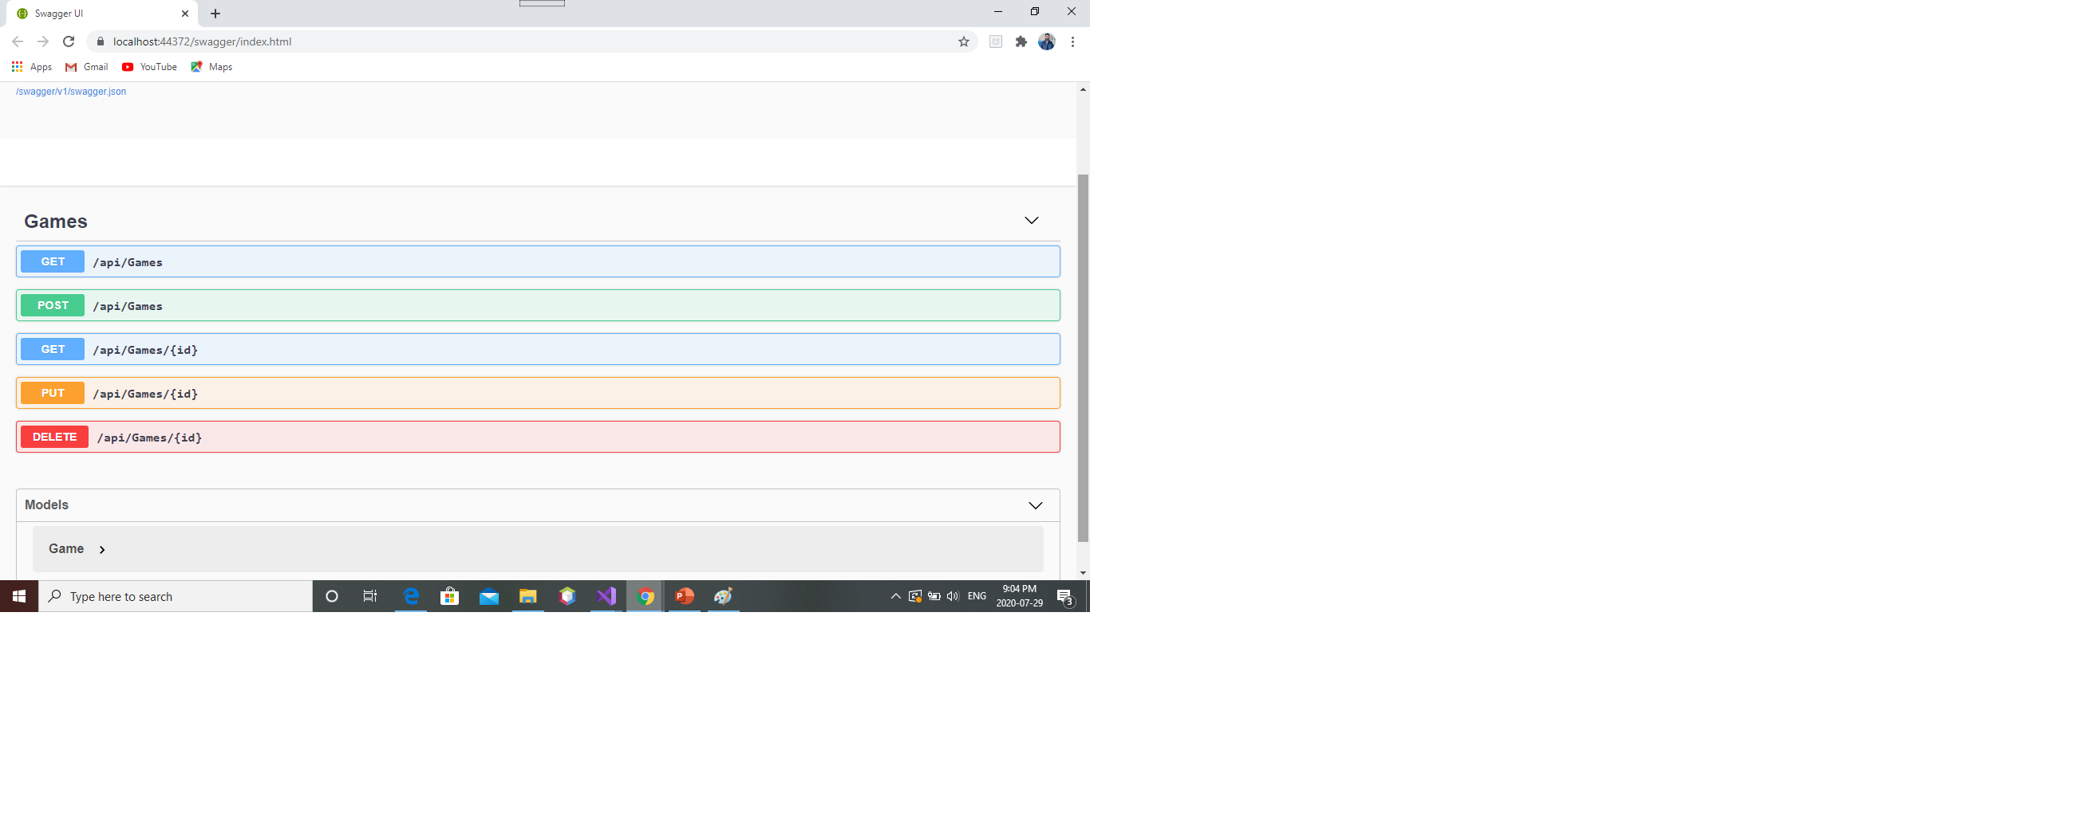
Test it out

Slide 28
Deploy your ASP.NET Core app to Azure

Slide 29
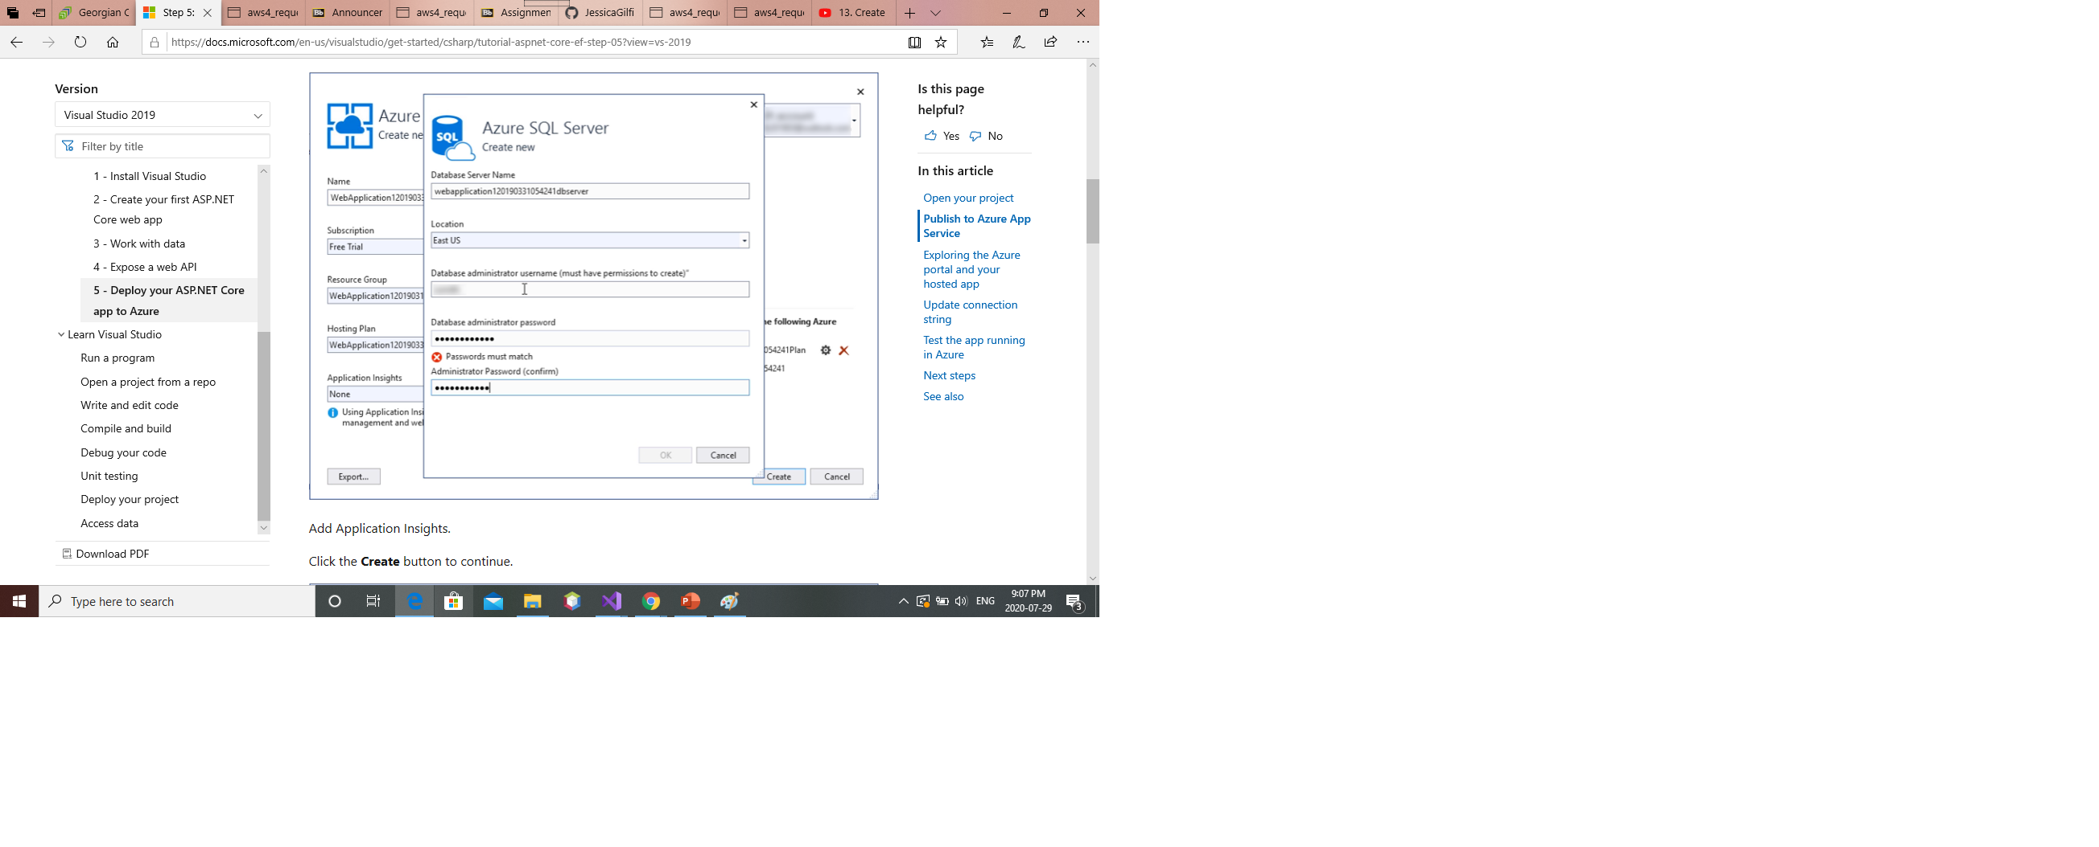
Publish to Azure App Service
Right-click on the project in solution explorer and choose Publish.
Leave the default settings of App Service and Create New and click the Publish button.
If you don't already have an Azure account, click the Create your Free Azure Account and complete the brief registration process.
Add Application Insights.
Click the Create button to continue.

Slide 30
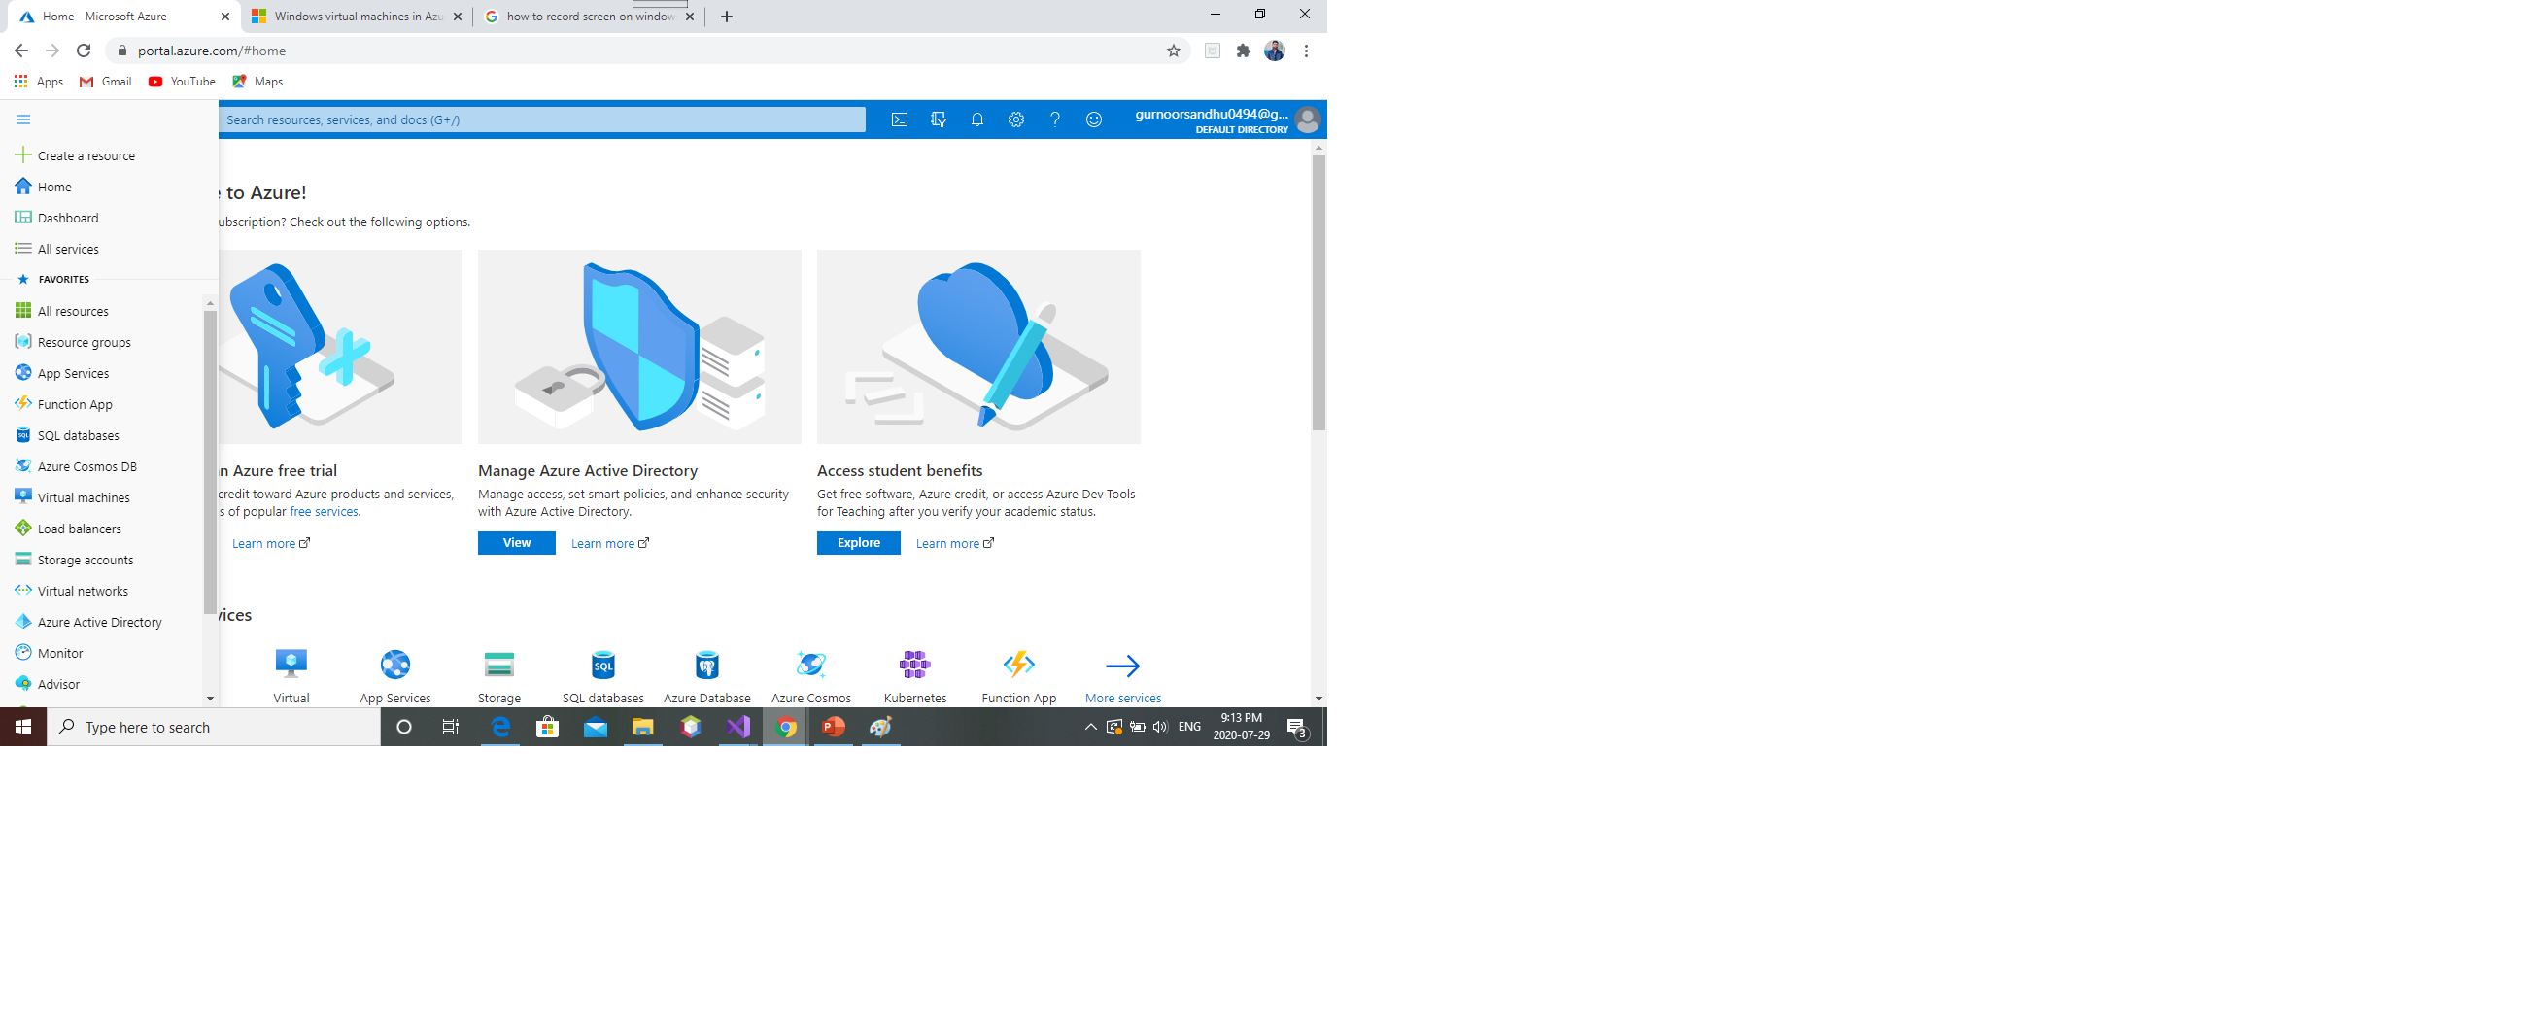
Exploring the Azure portal and your hosted app

Slide 31
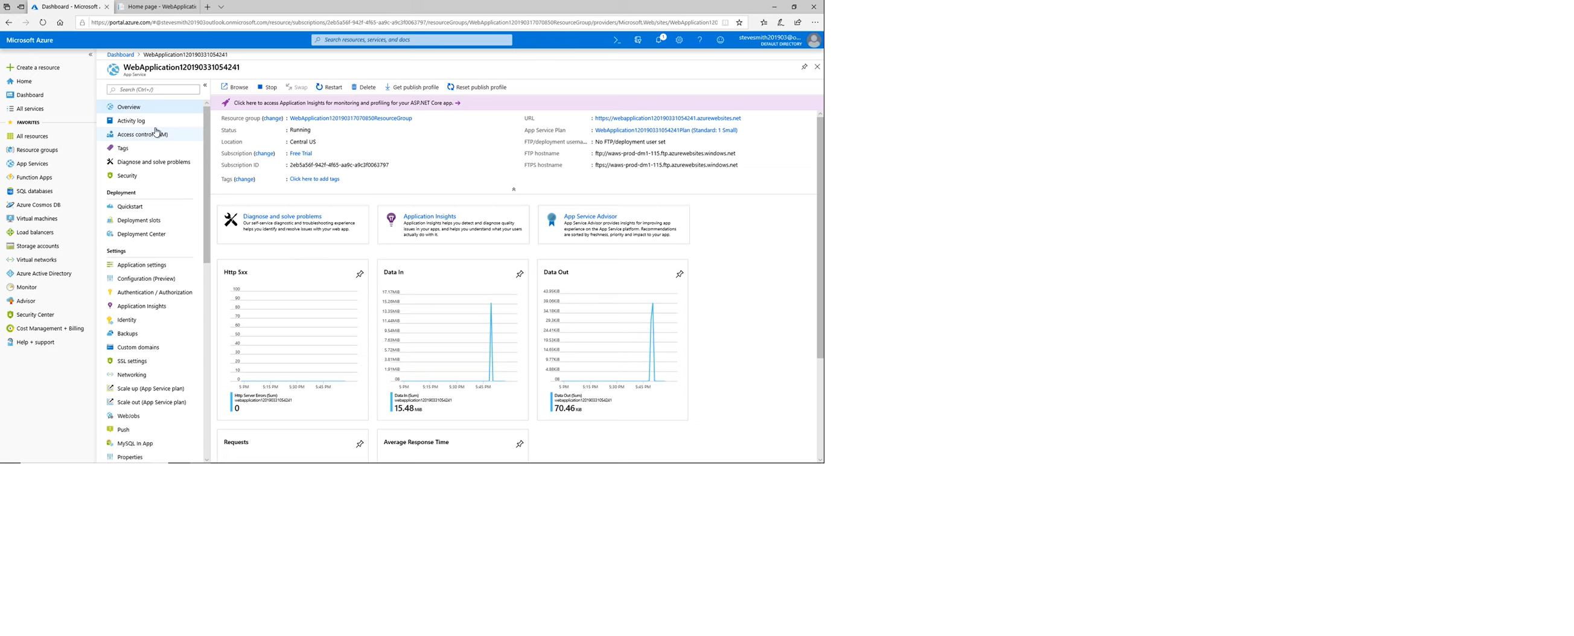
App service

Slide 32
Scalability:
Scaling up refers to increasing the resources given to each instance hosting your app. Scaling out refers to increasing the number of instances hosting your app.
Security and compliance:
Azure App Service provides ISO, SOC, and PCI compliance. These features are accessed in the Authentication / Authorization, Identity, backups, and SSL Settings menu options.
Deployment slots:
Deployment Slots avoid this issue by allowing you to deploy to a separate staging instance or set of instances and warm these up before swapping them into production.

Slide 33
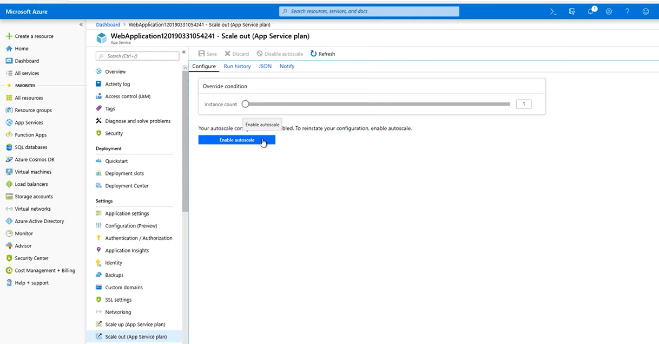
scalibility

Slide 34
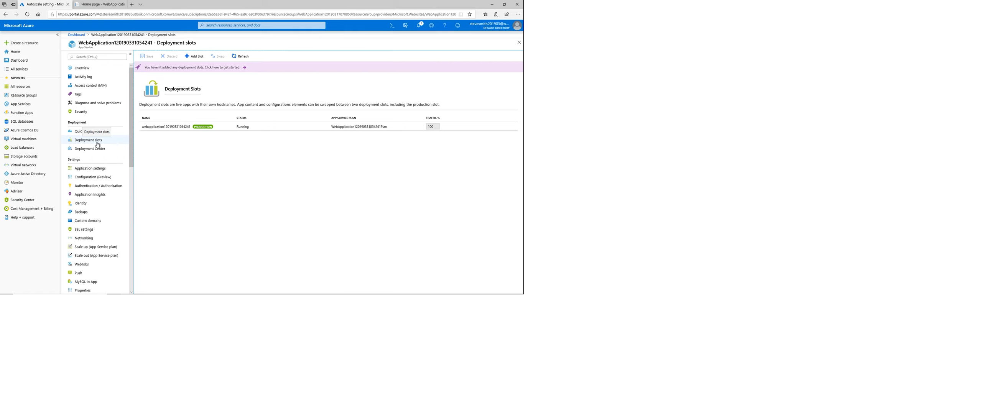
Deployment slots

Slide 35
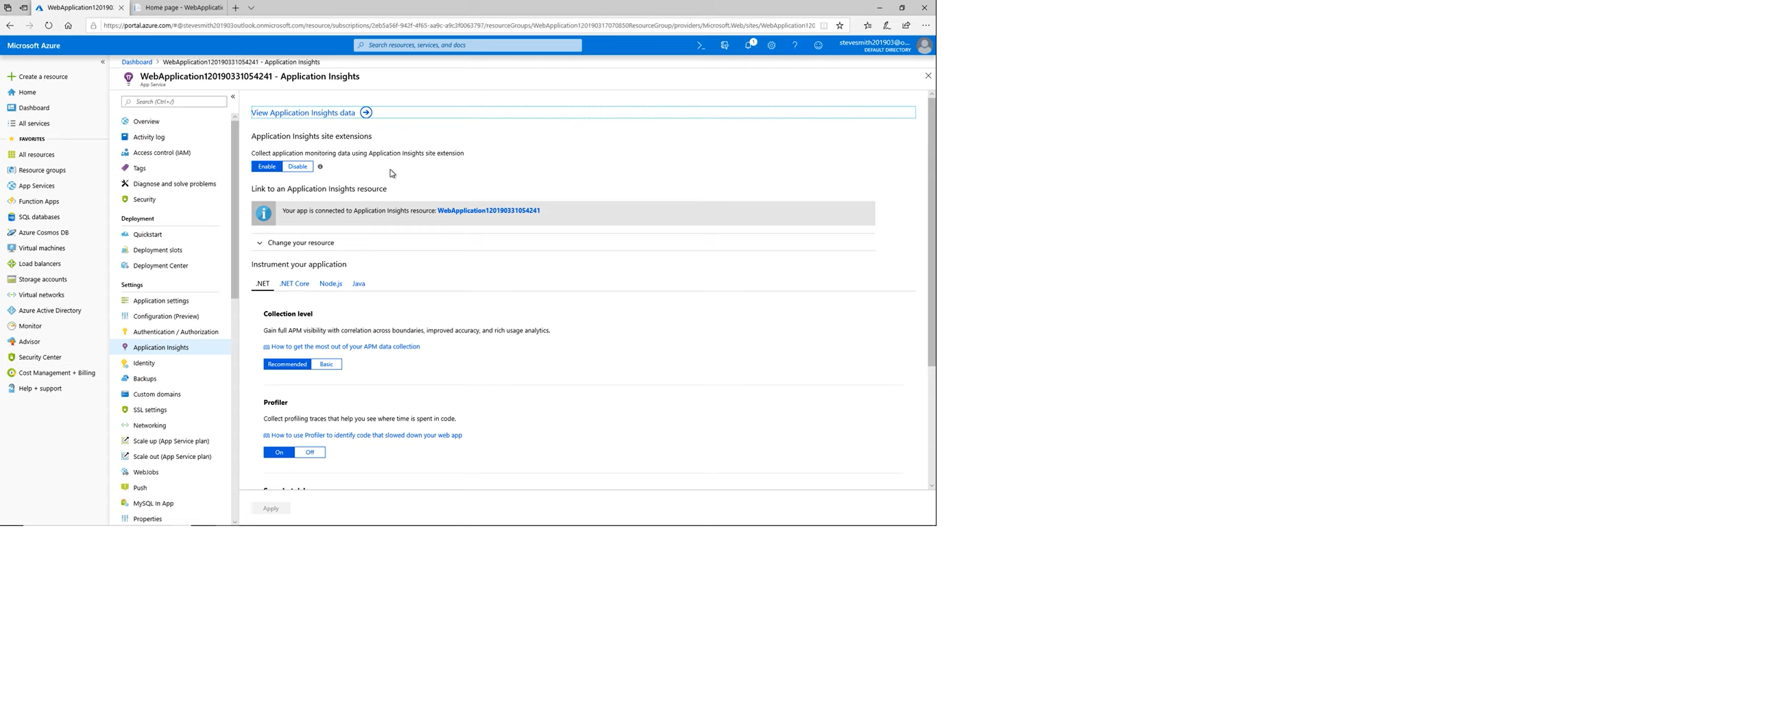
Application insights

Slide 36


